Slide 1

Coordinate Transformation
Scaling
Translation
Rotation
$$p_{B}=f(p_{A})$$
Coordinate transformation is a function applied to express a point in frame A in another frame ‘B’

Slide 2
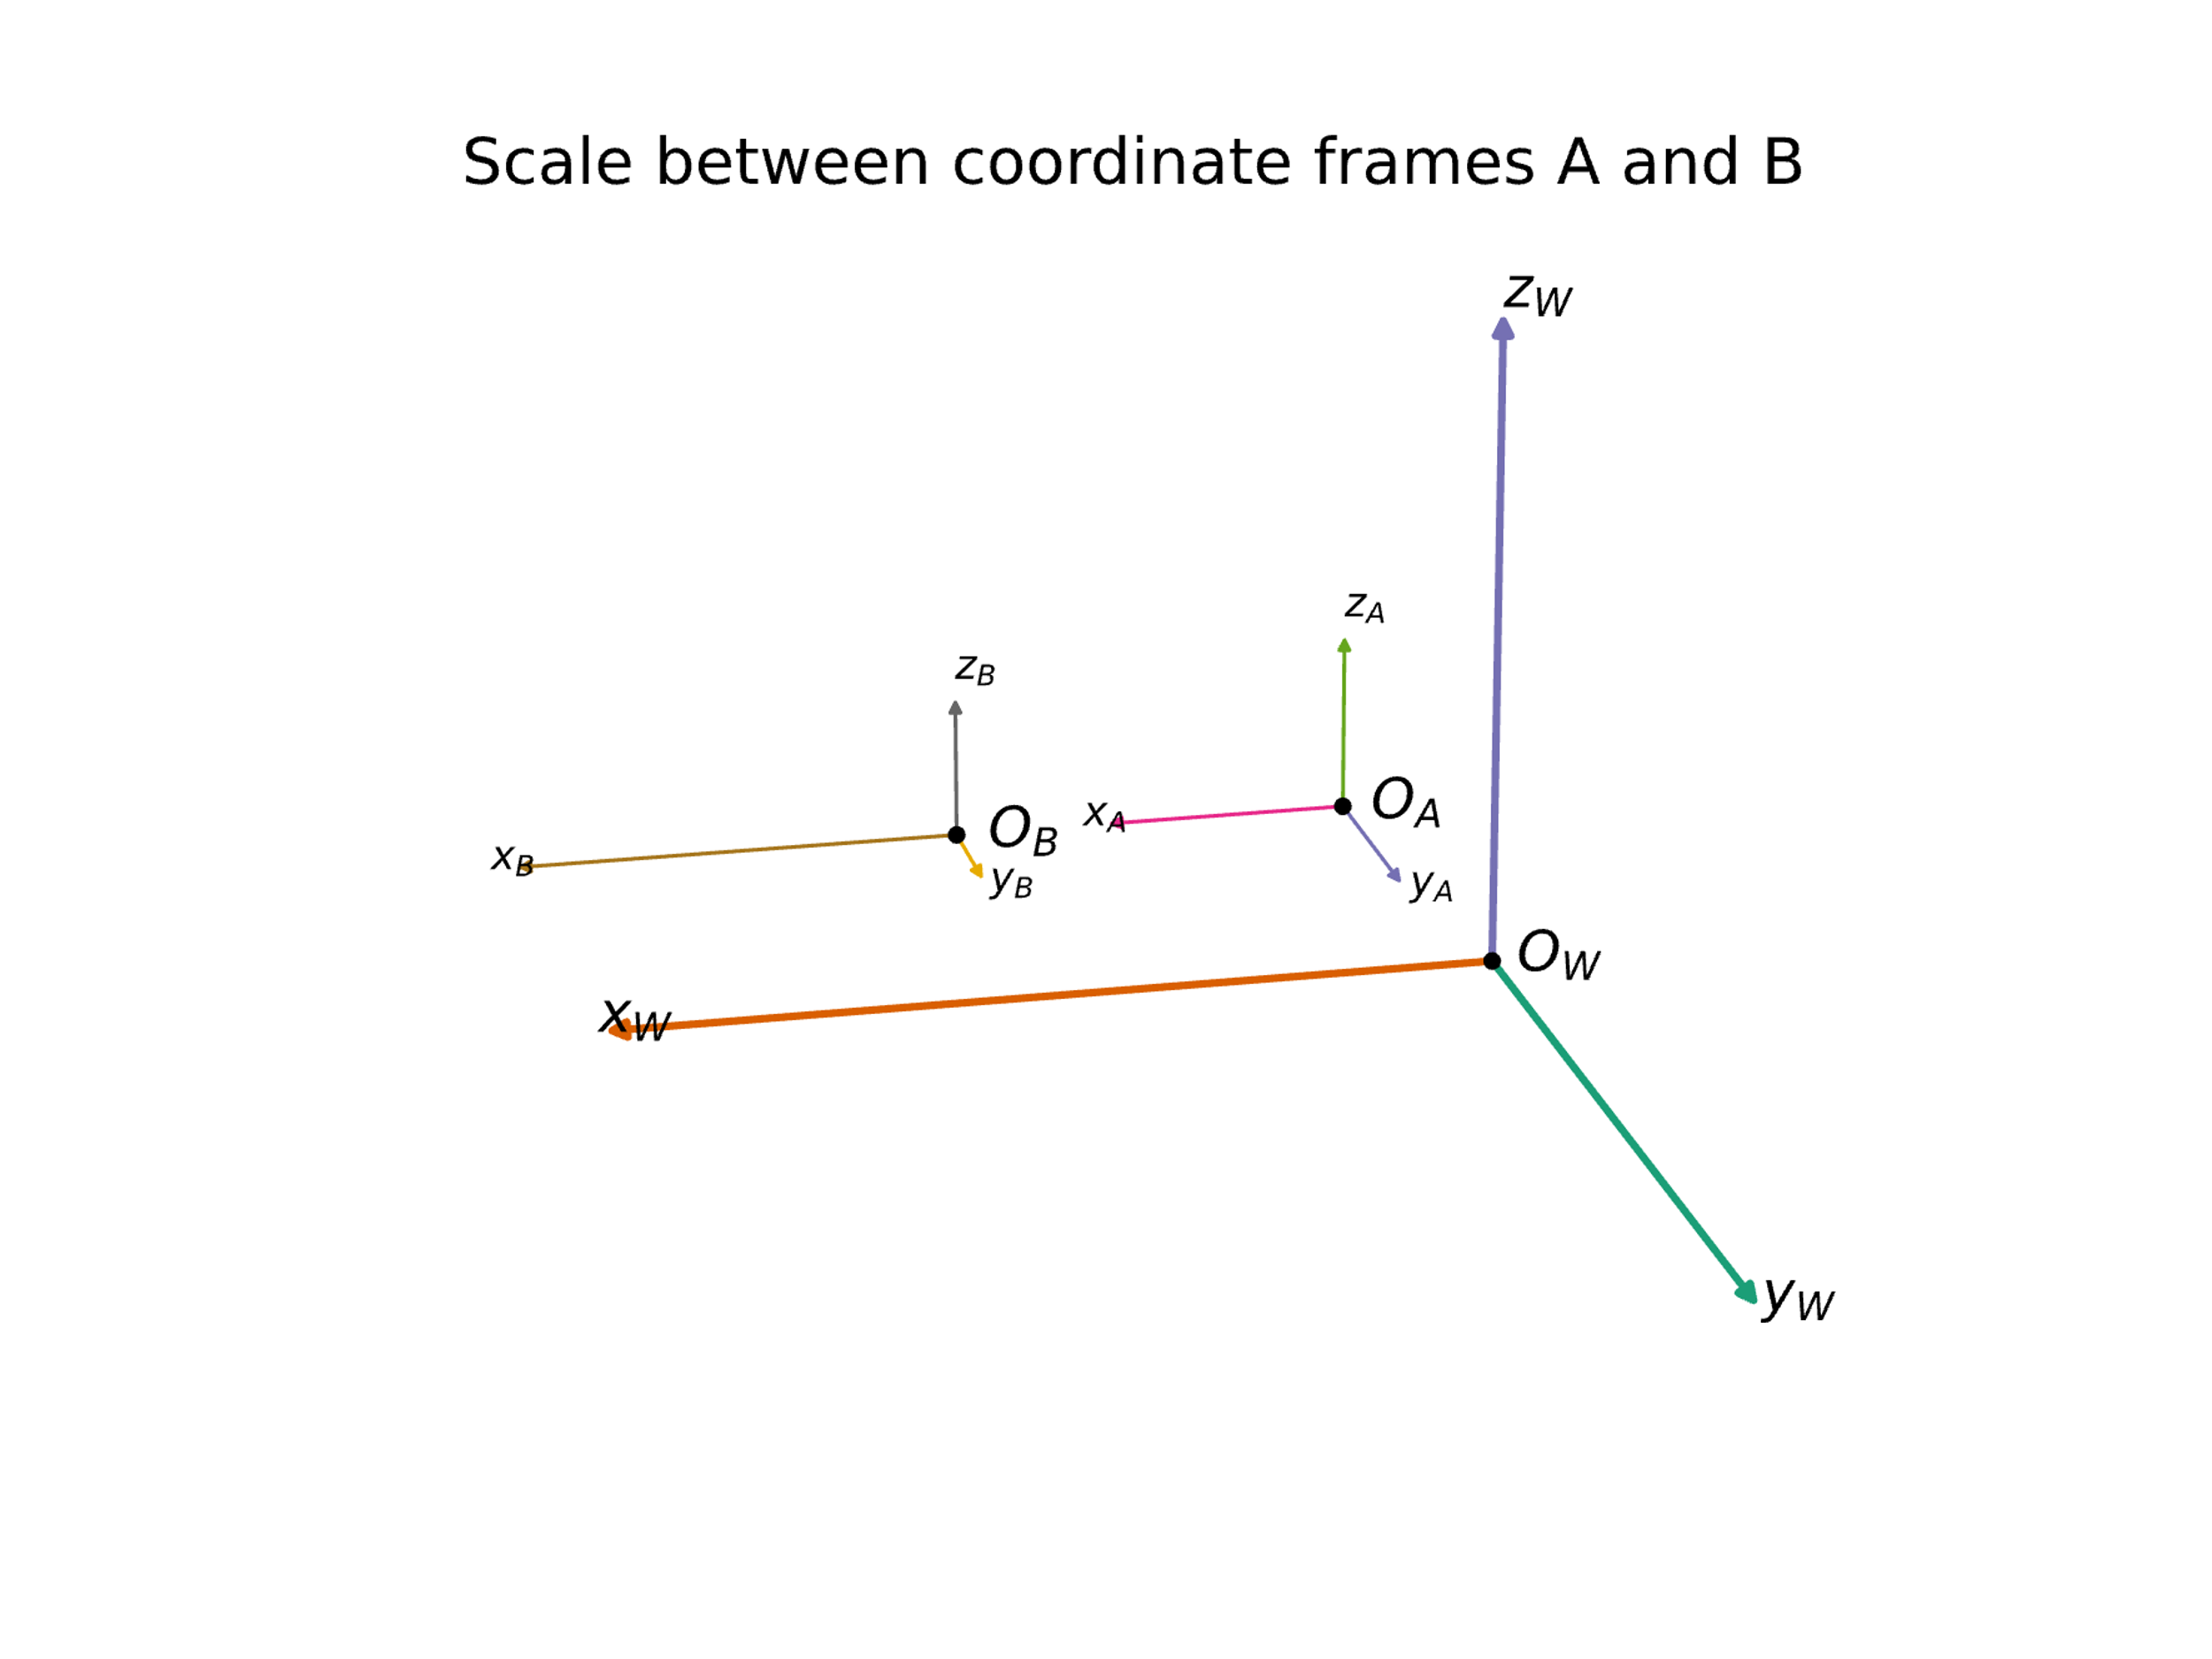
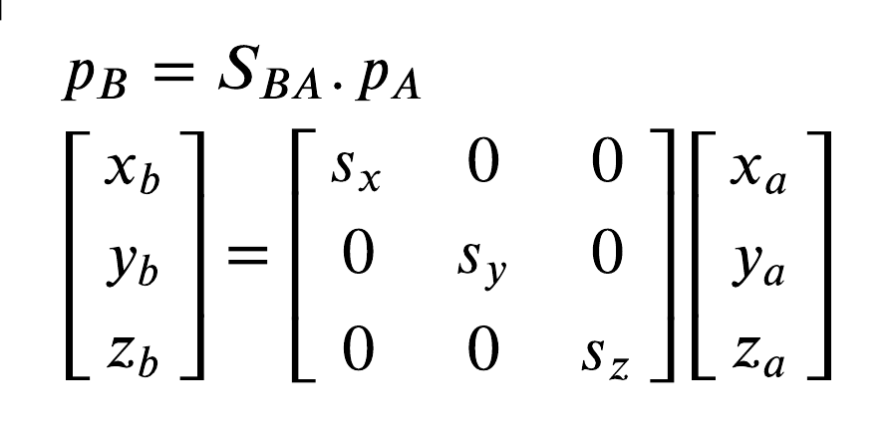
Coordinate Transformation
Scaling
Scaling: Notice the different lengths of axes

Slide 3
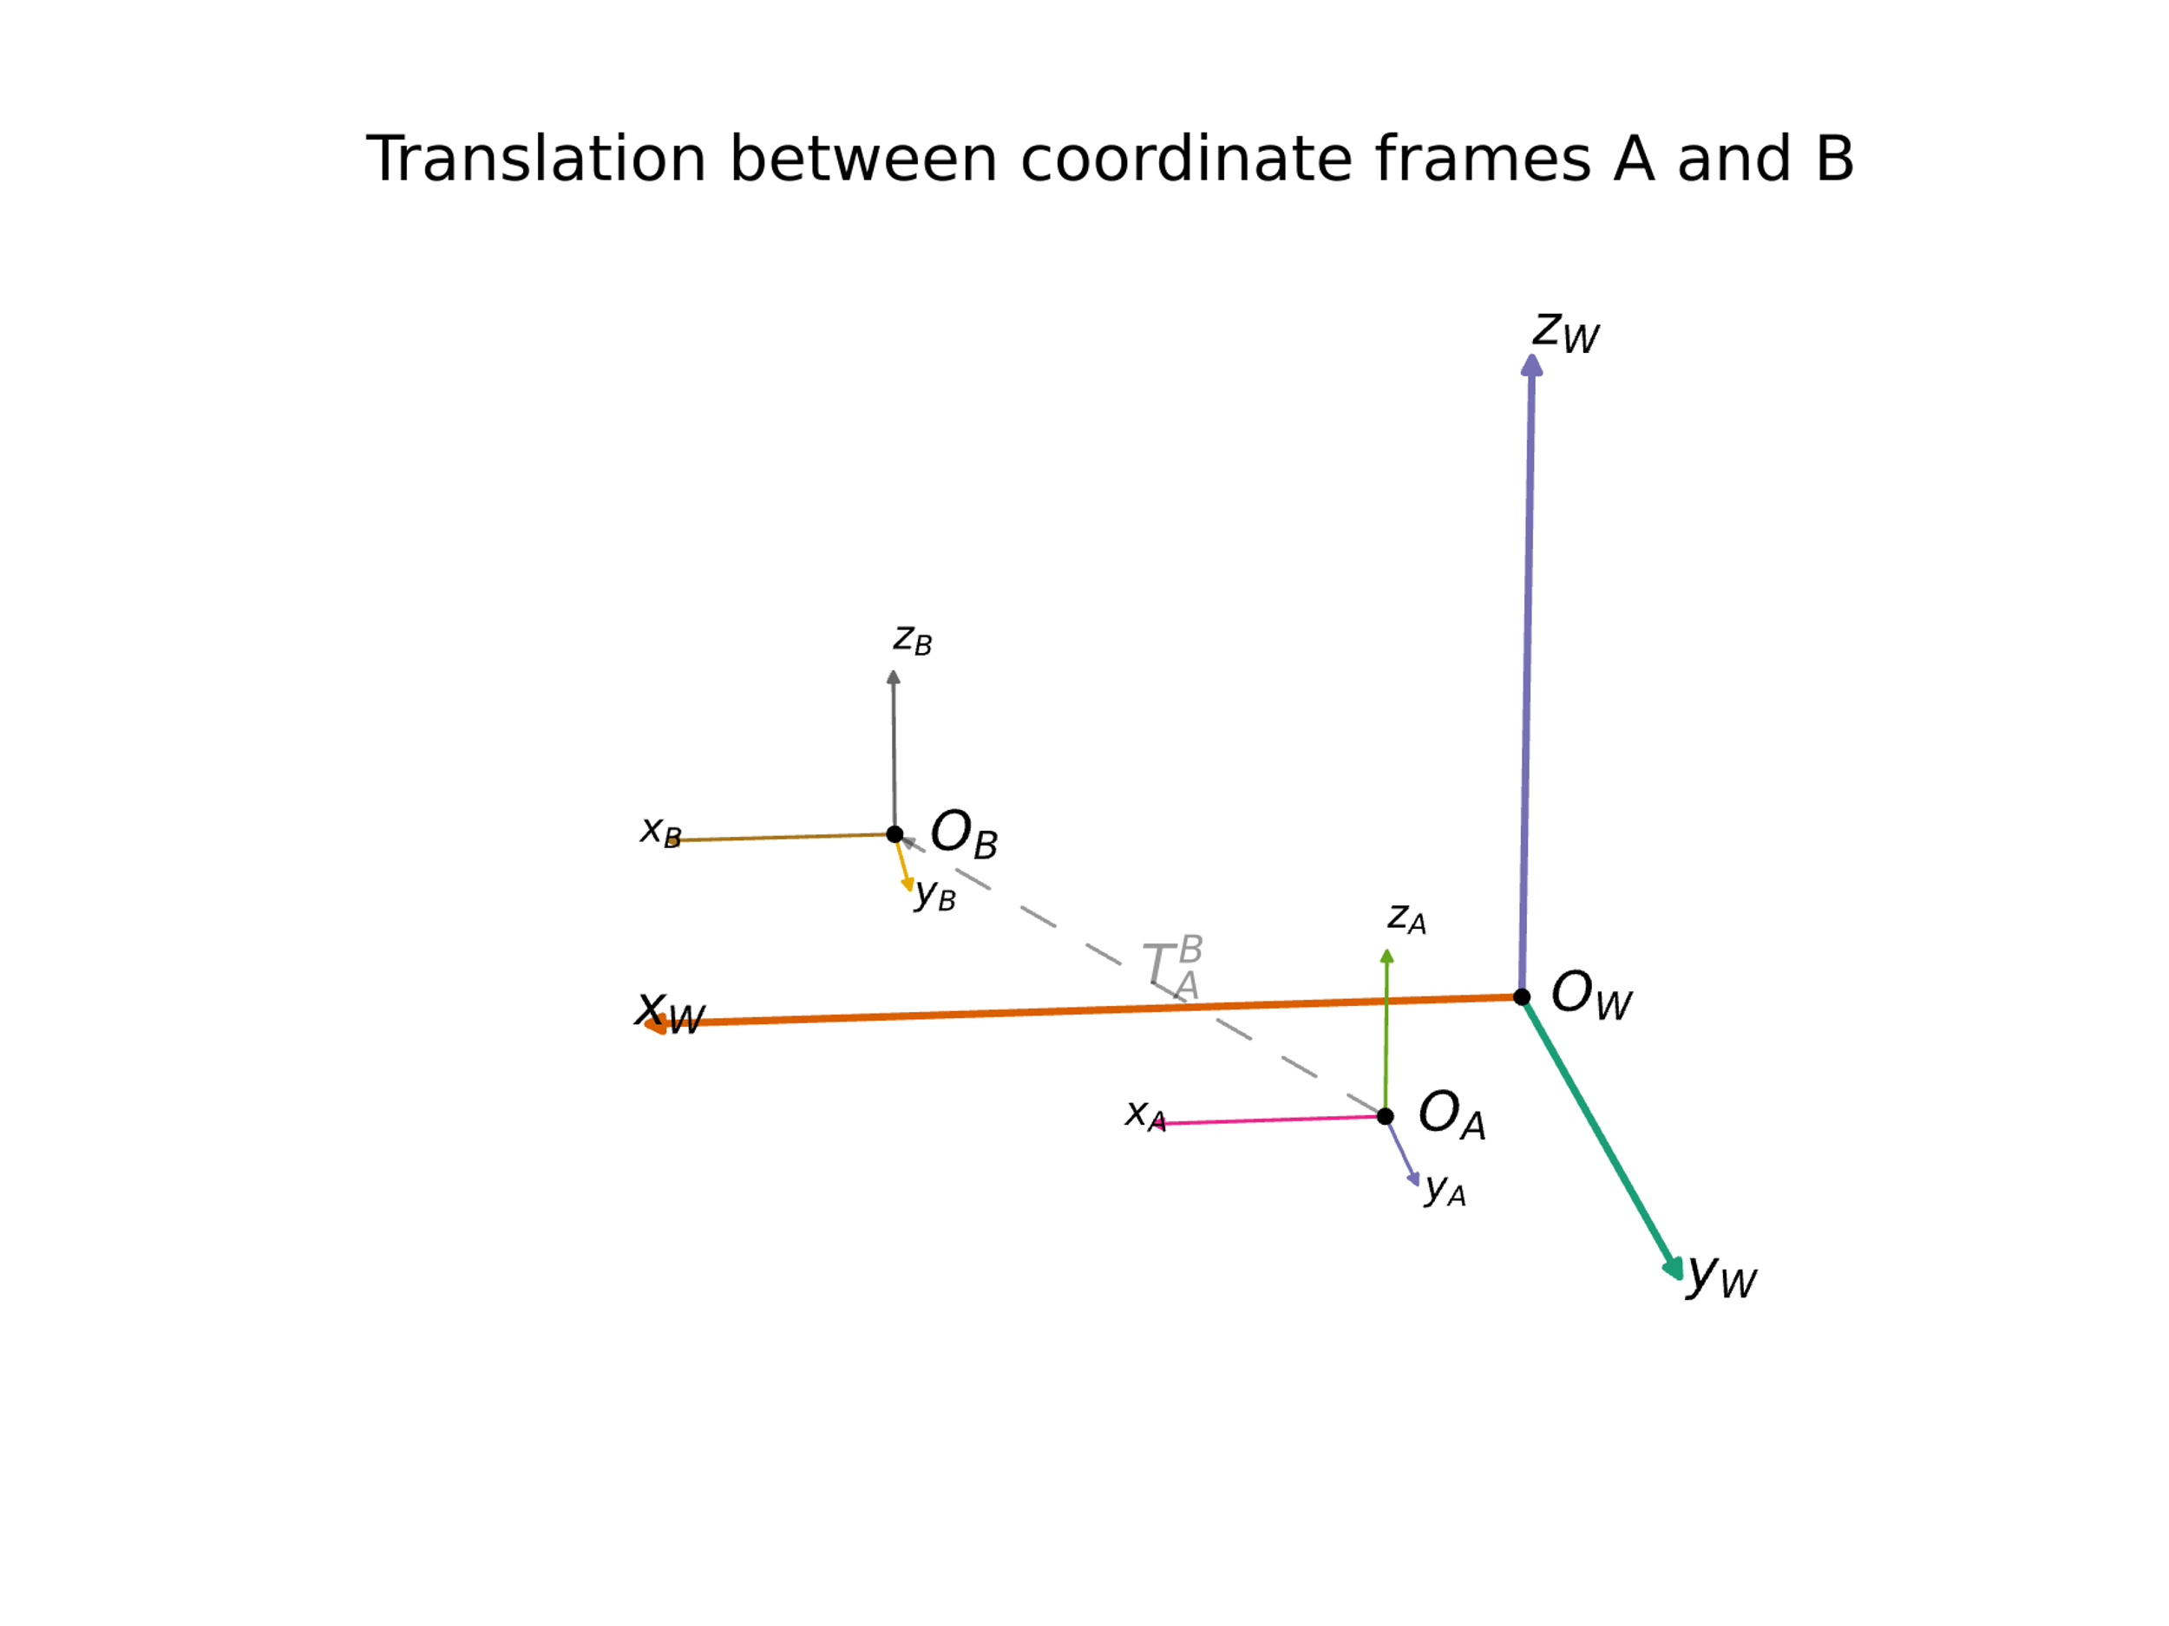
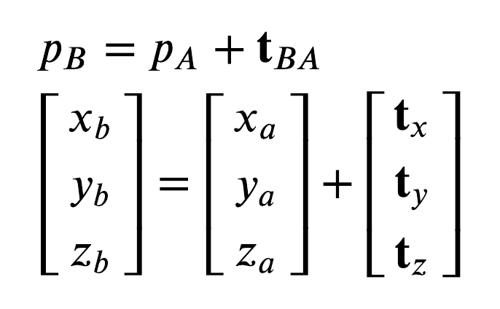
Coordinate Transformation
Translation
Translation between frames A and B

Slide 4
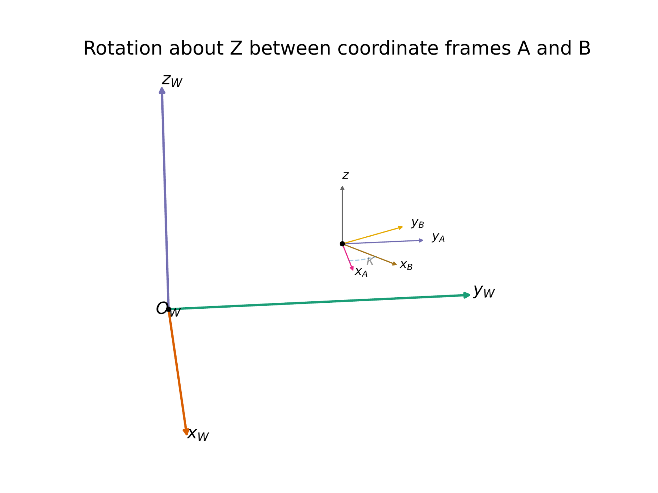
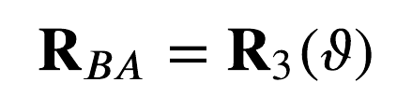
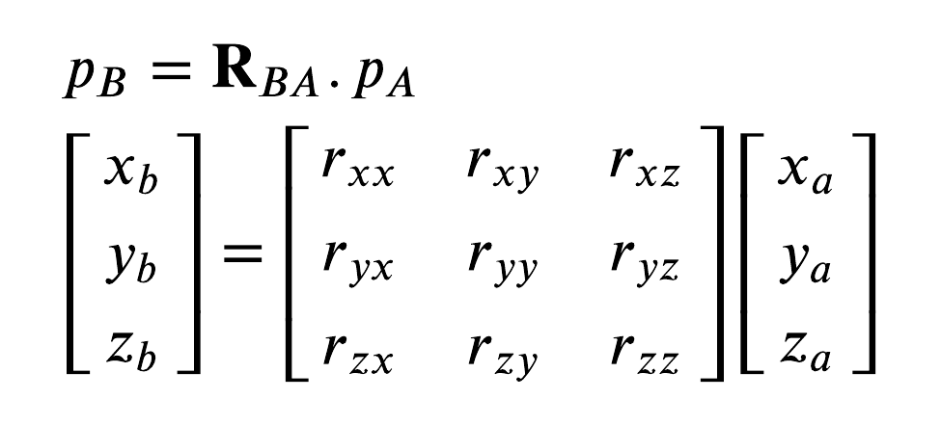
Coordinate Transformation
Rotation
Rotation between frames A and B

Slide 5
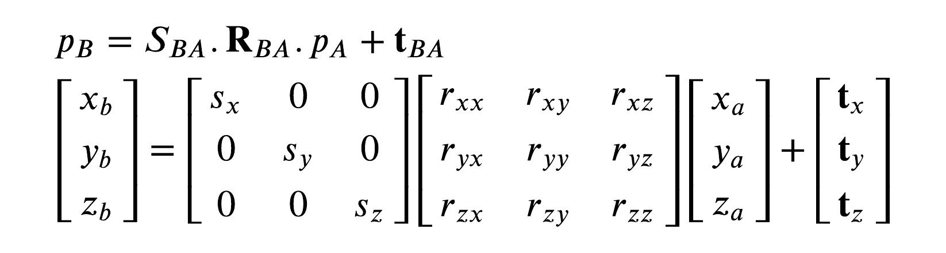

Coordinate Transformation
Rotation -> scaling -> translation
$$p_{B}=f(p_{A})$$

Slide 6

Coordinate Transformation
Rotation -> scaling -> translation
$$p_{B}=f(p_{A})$$

Slide 7
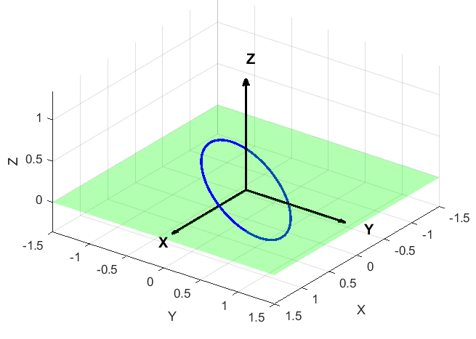
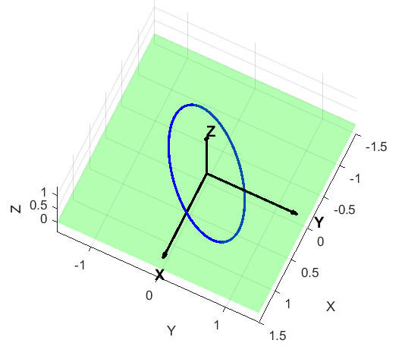
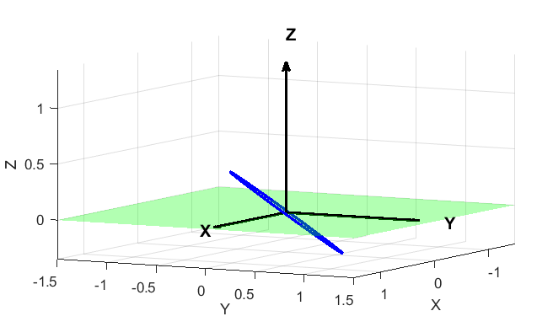
3-1-3 Euler Angle Sequence
Ascending Node direction
Periapse direction
Right Ascension of the Ascending Node Ω
Inclination (i)
Argument of Periapsis ω
Rotation about x-axis of intermediate frame
Rotation about the local z (angular momentum)

Slide 8
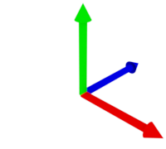





$$T_{A→B}=\left\{R, t\right\}$$
$$R$$
$$t$$
B
$$O$$
A
$$T_{B→A}=?$$

